Slide 1
Modern America: Ford to the present
Unit 12

Slide 2
President Gerald Ford
1974-1976
Formerly Vice President
and member of U.S. House of Representatives (R-MI)

Slide 3
Domestic Issues/Policy
In an act that angered many, Ford pardoned Nixon of any potential crime.
Tried to repair the ailing economy with his plan known as Whip Inflation Now or “WIN.” It was a $4 billion budget cut and an increase in corporate taxes. It additionally sought voluntary cutbacks from citizens. Congress didn’t pass it.
Why didn’t it pass? (posit 2 reasons)

Slide 4
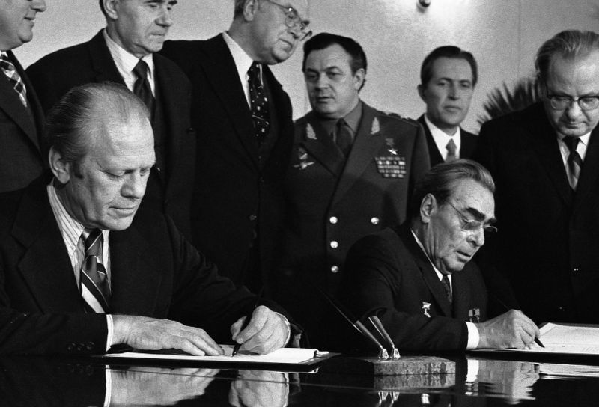
Foreign Issues/Policy
Ford was one of the signatories on the “Helsinki Accords” (1975) where 30 (mostly European) nations promised to cooperate and improve human rights conditions in the world
Ford also signed the SALT (Strategic Arms Limitations Treaty) Treaty that Nixon had developed in order to …

Slide 5
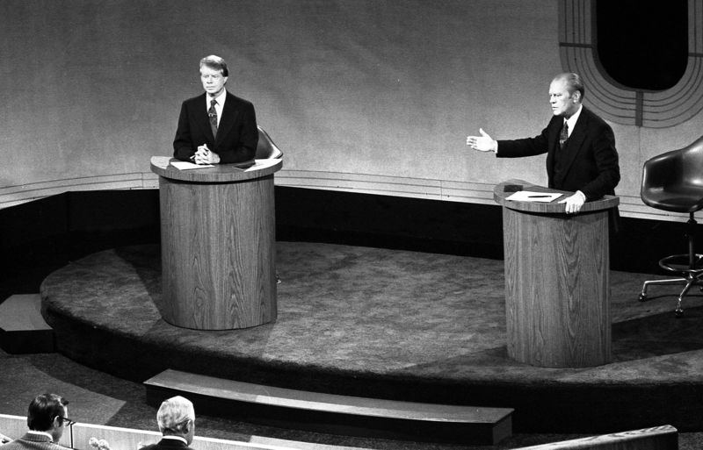
Election of 1976
Jimmy Carter (D)
Gerald Ford (R)
Carter wins
Very close

Slide 6
Blue=Carter Green=Ford

Slide 7
President Jimmy Carter
1976-1980
Formerly Governor of Georgia

Slide 8
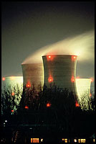
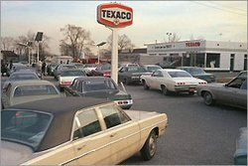
Domestic Issues/Policy
The economy continued to tank due to high unemployment and high rates of inflation.
Energy Crisis: The price of oil rose 400% due to an embargo by OPEC. This led to shortages and long lines at the pump.
Led Carter to create the Department of Energy to combat this energy crisis (and avert future crises).
This led to search for alternative fuel sources. Nuclear power became the answer to some, but not all, of our problems. Other alternatives?

Slide 9
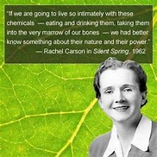
Domestic Problems:
These issues shone a bright light on environmental issues in America. The environmental movement was started by the publication of Silent Spring by Rachel Carson in the 1960s.
This caused the government to establish the Environmental Protection Agency (EPA) in 1970. This agency was tasked with organizing and enforcing myriad environmental laws and regulations.

Slide 10
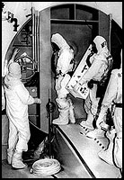
Domestic Problems:
Disaster at 3 Mile Island (Harrisburg, PA) in 1979 caused the evacuation of 100,000 people
A cooling malfunction caused part of the core to melt.
Some radioactive gas was released a couple of days after the accident, but not enough to cause any issues for locals.
There were no injuries or adverse health effects from the Three Mile Island accident.
This caused much fear throughout the nation

Slide 11
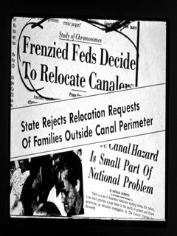
Domestic Problems:
Toxic chemicals dumped into a canal that was covered with dirt. Houses were later built here. Many people got sick.
The government finally bought out people’s homes and relocated them in 1979.
Love Canal

Slide 12
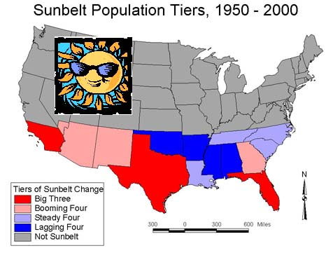
Domestic affairs:
More people from the north and northeast (the RustBelt) began a migration to the southern regions of the country known as the SunBelt in the late 1970’s.

Slide 13
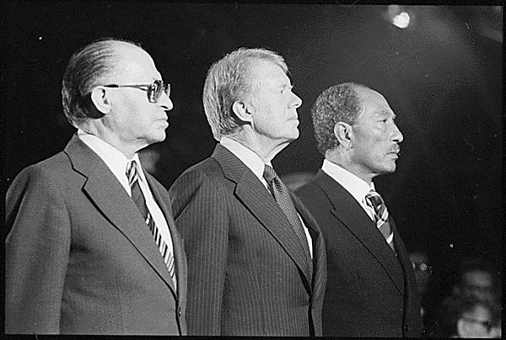
Foreign Issues/Policy
Carter negotiated the SALT II (Strategic Arms Limitations Treaty) Treaty , but Congress refused to sign off on it following the Soviet Union’s invasion of Afghanistan.
Carter negotiated the Camp David Accords: a peace treaty between Anwar Sadat of Egypt and Menachem Begin of Israel.
Brought peace to the ____________.

Slide 14
Shah of Iran Ayatollah Khomeini
Iranian Hostage Crisis
An Islamic Revolution took place in Iran in 1979
The US supported the Shah (who had cancer and came to an American hospital for treatment), but Ayatollah Khomeini, became Iran’s fundamentalist leader

Slide 15
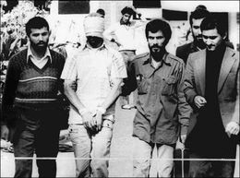
Iranian Hostage Crisis
Carter was humiliated 1979 when Iranians took 52 American Embassy hostages and held them for 444 days.
Diplomatic and military efforts failed, but Carter froze all Iranian financial assets in the U.S.
They were released just hours after Reagan’s inauguration in 1981.

Slide 16
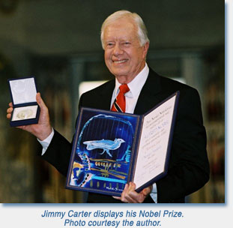
Jimmy Carter’s Life After the Presidency
Awarded the Nobel Peace Prize in 2002 for peaceful solutions and social justice

Slide 17
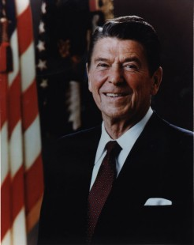
Ronald Reagan Republican 1981-1989
Won by a landslide in initial election and re-election
Carter unpopular because of Iranian Hostage Crisis and economy
Republicans majority in Senate; since 1954

Slide 18
ELECTION of 1980 Green=Reagan Blue=Carter

Slide 19
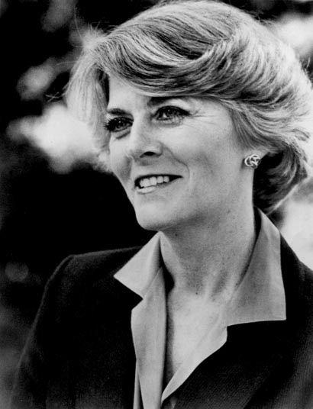
Election of 1984
Ronald Reagan (Republican)
Walter Mondale (Democratic)
Mondale selected Geraldine Ferraro for VP – the first female from a major party to run on a national ballot

Slide 20
Green=Reagan Blue=Mondale

Slide 21
Domestic Policy
Supply-Side Economics (aka “Voodoo Economics,” “Trickle-Down Economics,” and “Reaganomics”)
A pro-business economic theory based upon the idea that if you control the supply, then you can control the price
The implementation of this theory led to lower taxes and a reduction in federal spending on entitlement programs (such as job training, Welfare, and Medicare)
Who was this hurting? Helping?

Slide 22
Since taxes were cut, the idea was that the consumers would spend this money thereby helping the economy
Reaganomics did not help the poor (who didn’t have extra money to invest)
The tax cuts mainly helped the rich, such as stockbrokers who made a great deal of money as they bought/sold stock at overvalued prices.

Slide 23
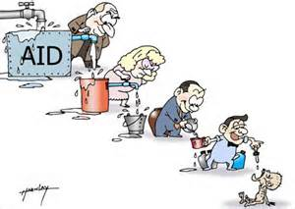
Lots of critics for Trickle Down Economics

Slide 24
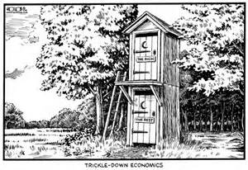
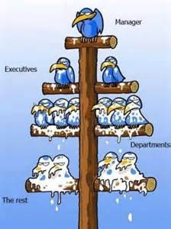
“The Rich”
“The Rest”

Slide 25
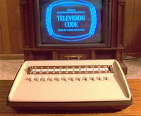
Other notable events during the Reagan presidency
The arrival of AIDS
The rise of discount stores
Cable TV on the rise (more Americans have)

Slide 26
A Nation at Risk takes the nation’s educational system to task—we are falling behind other industrialized nations.

Slide 27
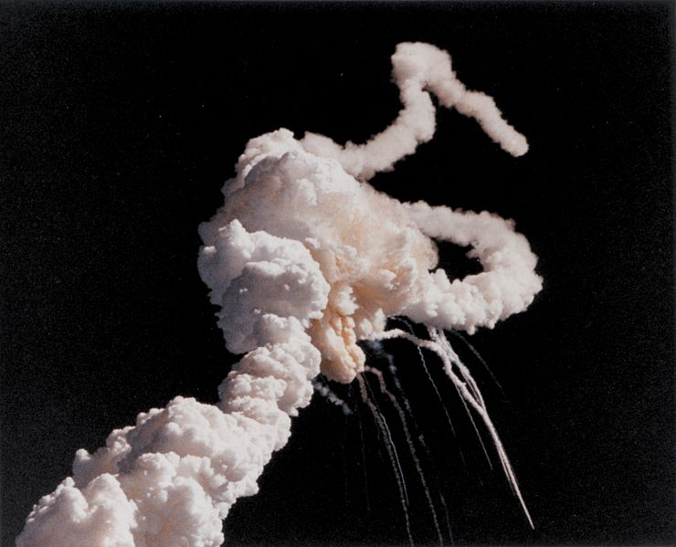
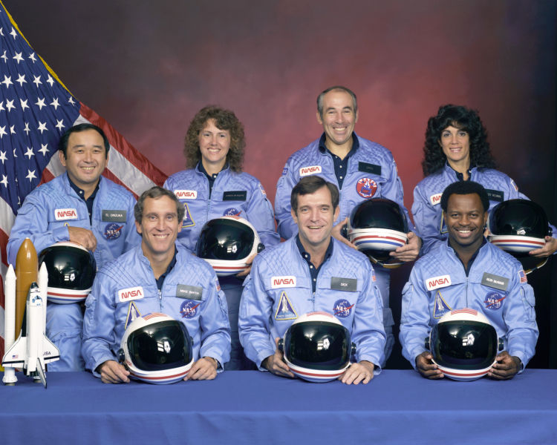
Space Disasters
In 1986 the Challenger exploded.
Seven astronauts died including the first teacher in space.

Slide 28
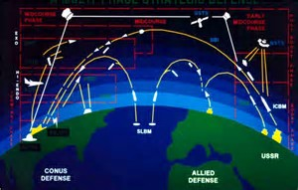
The economy meets foreign affairs
Strategic Defense Initiative (aka SDI and/or “Star Wars”)—was a space/ satellite defense system that was designed to detect and intercept missiles fired at the U.S. (by whom would they be fired?)
This was a VERY costly program that was never approved, but we do have some semblance of it today

Slide 29
Foreign Issues/Policy
Ronald Reagan intervened in the affairs of many nations during his presidency. Those nations included:
Nicaragua—gave money to and supported the “Contras” in their fight against the “Sandinistas”
Libya—dropped bombs to rattle the administration of their leader, Qadhafi, who supported terrorism
Lebanon—sent troops to prop up the government, but withdrew them after a terrorist bombed the Marine barracks and killed 200
Grenada—overthrew the government of the island in response to their cozying up to the Soviet Union
Panama—overthrew their government, and brought their former dictator, Manuel Noriega, to the U.S. to stand trial for drug trafficking

Slide 30
Iran-Contra Scandal
Reagan pressured other nations to isolate Iran, but he exchanged (sold) weapons to Iran in order to facilitate the release of some hostages held by pro-Iranian groups in Lebanon.
It enjoyed limited success.
Lebanese newspapers published details of these arms deals, but the Reagan White House denied the deal(s).
Where did the money from the arms sales go?

Slide 31
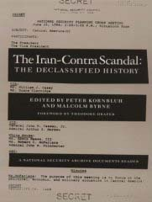
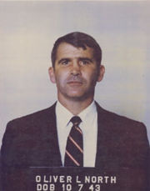
Reagan used the profits from the arms sale to give to the Contras
Congress investigated and held televised hearings on the matter
Lieutenant Colonel Oliver North, an NSC officer, reported that he attempted a cover up.
He was convicted of destroying government property, but the conviction was vacated on appeal.

Slide 32
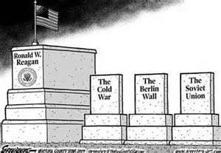
Foreign Issues/Policy
Reagan dislikes the Soviet Union—calls it the “evil empire.”
Reagan moves away from the Nixon policy of détente, due to his “Peace through Strength” strategy.

Slide 33
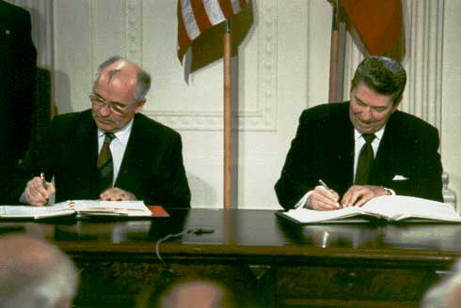
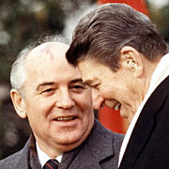
In 1987, US and USSR signed an agreement that limited the number of nuclear weapons (INF Treaty–this was similar to…)
Soviet President Mikhail Gorbachev introduces “Glasnost” (openness) which brings new Soviet freedoms.
Perestroika (economic restructuring) increased Soviet foreign trade and reduce military spending.
Reagan’s aggressive policies, along with Gorbachev’s reforms to the troubled political and economic system caused the downfall of the Soviet Union and its influence in other nations.

Slide 34
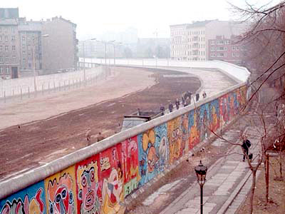
Beginning in November of 1989, the Berlin Wall is taken down by celebratory Germans from both the East and the West—paving the way for a re-unified Germany.
Partying on the wall
Pre-”fall” of the Berlin Wall

Slide 35
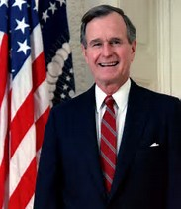
George H. W. Bush Republican 1989-1993
Won in an electoral vote (426-111) landslide over MA Democrat Michael Dukakis
Popular vote difference was just over 8 million

Slide 36
1988 Electoral Map Bush = Red Dukakis = Blue

Slide 37
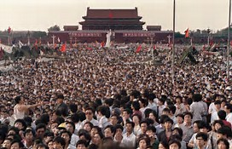
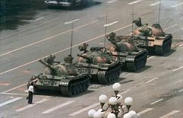
George H.W. Bush: Foreign Policy/ Affairs…Cold War
Pro-democracy demonstrations in China’s Tiananmen Square (1989)
Mainly led by students protesting for more human rights and political freedom in the face of lessening of economic restrictions

Slide 38
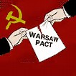
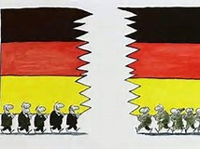
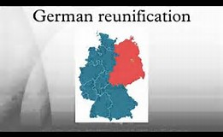
George H.W. Bush: Foreign Policy/ Affairs…Cold War
Soviets withdraw their troops from Afghanistan
This is viewed by many/most to be Russia’s Vietnam
Following the fall of the Berlin Wall (and communism in Eastern Europe), the Warsaw Pact disbands
East Germany and West Germany cease to exist any longer as the reunification movement succeeds…a single Germany again

Slide 39
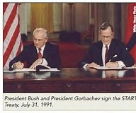
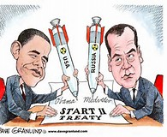
George H.W. Bush: Foreign Policy/ Affairs…End of the Cold War
START (Strategic Arms Reduction Treaty) was agreed to by the U.S. and the soon-to-be-former-Soviet Union in 1991
It, obviously, reduced the number of strategic arms held and produced by each nation (read that as nuclear weapons)
We continue to negotiate treaties like this…most recently 2016 with President Obama and Russian Foreign Minister Medvedev

Slide 40
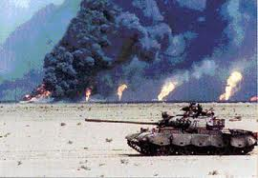
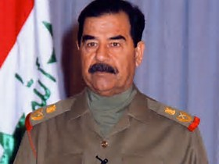
George H.W. Bush: Foreign Policy/Affairs
Iraq (Saddam Hussein) invades Kuwait in August 1990 (and threatens to invade Saudi Arabia
We respond in January 1991 (Persian Gulf War/1st Iraqi War/Operation Desert Storm) with a 100 hour ground offensive and 5-week bombing campaign
All designed to liberate Kuwait

Slide 41
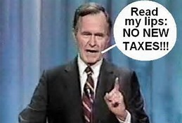
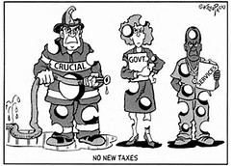
George H.W. Bush: Domestic Policy
Campaigned on promise of “No New Taxes!”
Due to an economic recession and a desire to deal with a rising budget deficit, he goes back on his word and supports a tax increase
A factor in his defeat in the 1992 election

Slide 42
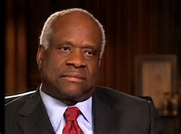
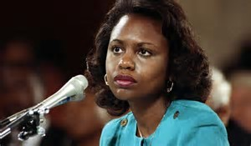
George H.W. Bush: Domestic Policy
Appointed 2 members to the United States Supreme Court
One was Clarence Thomas…the 2nd African-American appointed to the Court
The country was introduced to the term “sexual harassment” during his confirmation hearings
His accuser…Anita Hill

Slide 43
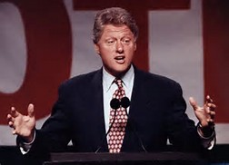
William Jefferson “Bill” Clinton Democrat 1993-2001
Won in odd election with a plurality of the votes over GHW Bush (and Ross Perot) in 1992
Soundly defeated Bob Dole in 1996 (by 220 electoral and 8.2M popular votes)
VERY Popular POTUS (among Democrats) even today

Slide 44
1992 Electoral Map Bush = Red Clinton = Blue

Slide 45
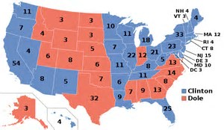
1996 Electoral Map Dole = Red Clinton = Blue

Slide 46
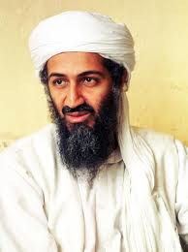
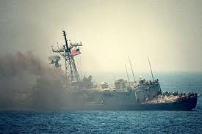
Bill Clinton: Foreign affairs/Policy
American troops attacked in Somalia (Black Hawk Down)
World Trade Center basement is bombed.
World Islamic Front calls for the deaths of Americans and Jews oppressing Muslims and holy lands.
U.S. Embassy bombed in Kenya and Tanzania. Al Qaeda and Osama bin Laden are suspected.
USS Cole is attacked in Yemen. Credit claimed by Al Qaeda and Osama bin Laden

Slide 47
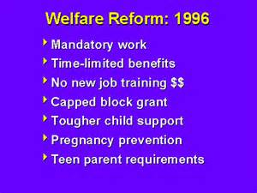
Bill Clinton: Domestic affairs/Policy
Internet/.com Boom
Internet businesses boomed during the 90s
Led to economic growth and balanced fed budget
Main idea is to stop the cycle of dependency on government aid

Slide 48
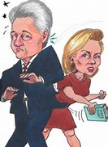
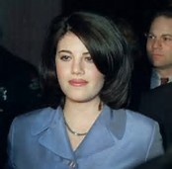
Bill Clinton: Domestic affairs/Policy
Many concerns about questionable business dealings and stories relating to him having made improper sexual advances to women (before and during campaign)
Incident involving an intern (Monica Lewinsky) in the White House resulted in an investigation and a special prosecutor (Kenneth Starr)
Issued a report very critical of the president
President Clinton was impeached by the House, but he was not found guilty nor removed from office

Slide 49
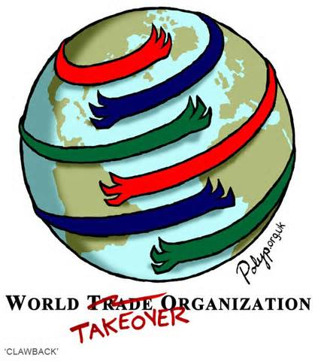
Bill Clinton: Domestic and Foreign affairs/ Policy
Increasing globalization of trade
GATT (General Agreement on Tariffs and Trade) was replaced by the WTO (World Trade Organization)
The WTO is an organization of member nations that seeks to promote free trade around the world. It has enforcement power, so it can punish nations who break the rules.
There are many critics of the WTO.

Slide 50
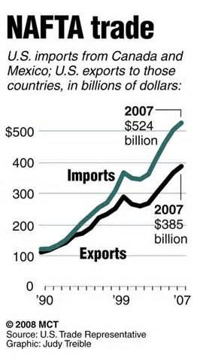
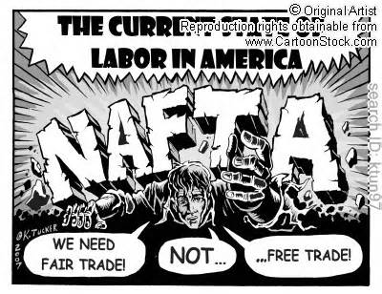
Bill Clinton: Domestic and Foreign affairs/ Policy
North American Free Trade Agreement (NAFTA) between the U.S., Mexico, and Canada
It dropped all tariffs between the countries of North America which has increased trade
Controversial and not universally supported by the American public (especially labor unions), but it was adopted by the United States under the leadership of President Clinton.
Has been a positive for Mexico, but has caused much unemployment in the U.S.

Slide 53
Bill Clinton: Domestic and Foreign affairs/ Policy
Global Warming became a major concern in the mid-1980s, but it continues to be a hot button issue even to today. Global Warming is also known by the following terms:
Greenhouse Effect
Ozone Layer Depletion
Vice President Al Gore published An Inconvenient Truth, to draw attention to the effects of global warming. He won an Oscar, Grammy, and Nobel Prize for this work.
Kyoto Protocol-a 1997 legally binding international agreement that limits the emission of carbon. The goal, of course, is to forestall global warming.
The U.S. signed it, but never put it into effect (due to George W. Bush’s administration withdrawing their support for it).

Slide 54
George W. Bush Republican 2001-2009
Won a contested election over Al Gore—by 4 electoral votes even though he lost by over 500,000 popular votes—in 2000
More easily won re-election in 2004 (286-251 electoral votes; 50.1 % - 48.3% of popular votes)
A very polarizing POTUS

Slide 55
2000 Electoral Map Bush = Red Gore = Blue

Slide 56
2004 Electoral Map Bush = Red Kerry = Blue

Slide 57
George W. Bush: Foreign Affairs/ Policy
September 11th Attacks--World Trade Centers, the Pentagon, and PA field
Bio-chemical warfare scare w/ anthrax found in Washington, DC
War in Afghanistan against Al Quaeda, Osama bin Laden, and the Taliban
2nd Gulf War in Iraq begun over…
Capture and death of Saddam Hussein

Slide 58
George W. Bush: Foreign Affairs/ Policy
In the wake of 9/11and the wars against Taliban and Iraq, President Bush declared a “war on terrorism.”
Created the Department of Homeland Security in 11/2002 to protect the nation, and it took in a number of existing government agencies (e.g. ICE).

Slide 59
George W. Bush: Domestic Affairs/ Policy
Presided over the start of “The Great Recession” which was caused by a global economic downturn following 9/11, the second Iraq War, Afghanistan, etc. Another contributing factor were tax cuts passed early in his first term.
He received much criticism for his decision to champion and approve “bail outs” for some big businesses…those were dubbed “too big to fail” (e.g. General Motors, etc.).
Criticized for his handling of relief in the wake of Hurricane Katrina
Supported and approved of “No Child Left Behind” (which you can thank for your MAP and SATP tests)

Slide 60
Barack H. Obama Democrat 2009-2017
Won fairly easily in both elections
The first African-American POTUS
Had his citizenship (and therefore qualifications for office) questioned by many
Won Nobel Peace Prize in 2009
A very polarizing POTUS

Slide 61
2008 Electoral Map McCain = Red Obama = Blue

Slide 62
2012 Electoral Map Romney = Red Obama = Blue

Slide 63
Barack ObamA: Foreign Policy/Affairs
“Removal” of Osama bin Laden (Seal Team Six)
Bombing of U.S. Embassy in Libya
Boston Marathon Bombing
Sought to improve relations with international community
Banned “enhanced” interrogation techniques

Slide 64
Barack ObamA: Foreign Policy/Affairs
Normalized relations with Cuba
Fought against ISIS and Assad in Syria
Negotiated a nuclear deal with Iran

Slide 65
Barack ObamA: Domestic Policy/Affairs
President Obama sought to remedy the “Great Recession” upon taking office by pushing Congress to pass his “stimulus” package (a package of legislation similar to the New Deal which sought to use deficit spending to increase employment and consumer spending).
It was modestly successful.

Slide 66
Barack ObamA: Domestic Policy/Affairs
Social issues:
Racial Disharmony…George Zimmerman and Ferguson, MO
LGBTQ issues…same sex marriage and bathroom kerfuffle
Affordable Care Act (ObamaCare)…under attack by Trump
Clean Power Act—to reduce carbon emissions and improve the environment…just cancelled by Trump

Slide 67
Donald J. Trump Republican 2017-
Won an unlikely victory (won electoral vote, but lost popular vote)
Very polarizing
Has sought to cancel many Obama-era programs

Slide 68
2016 Electoral Map Trump = Red Clinton = Blue

