Slide 1
UNITED STATES HISTORY Unit 6 (CHAPTER 10)
The Roaring Twenties: The Clash of Traditionalism and Modernism

Slide 3
CHANGING WAYS OF LIFE
The biggest concern of most Americans following WWI was staying out of future world conflicts
This concept led to the rebirth of the following:
#1 Isolationism- pulling away from world affairs
Nativism- prejudice against foreign-born people
People feared communism as their goal was to end private ownership of business and property.
Anti-immigration activity:
Sacco and Vanzetti
#2 “Red Scare”- Fear of Communism
Ku Klux Klan- (KKK)
Emergency Quota Act (1921

Slide 4
“RED SCARE” POLITICAL CARTOONS

Slide 5
#3 Another major postwar issue in society was the growing conflict between labor and management.
Strikes had been outlawed during the war because it was potentially damaging to the war effort.
Upon the war’s conclusion, however, pay was still the same as it had been while the cost of living had increased.
Management did not want to give pay raises, which led to 3,000+ strikes in 1919.

Slide 7
Management used the #2 “Red Scare” to their advantage during all these strikes.
They began labeling striking workers as communists.
They claimed the striking workers were attempting to establish communism by striking.
The 1920s was a set back for labor movements and unions:
Unions became association with communism.
Large immigrant work force was willing to work for less money.

Slide 8
ANALYZE THE FOLLOWING CARTOON:

Slide 9
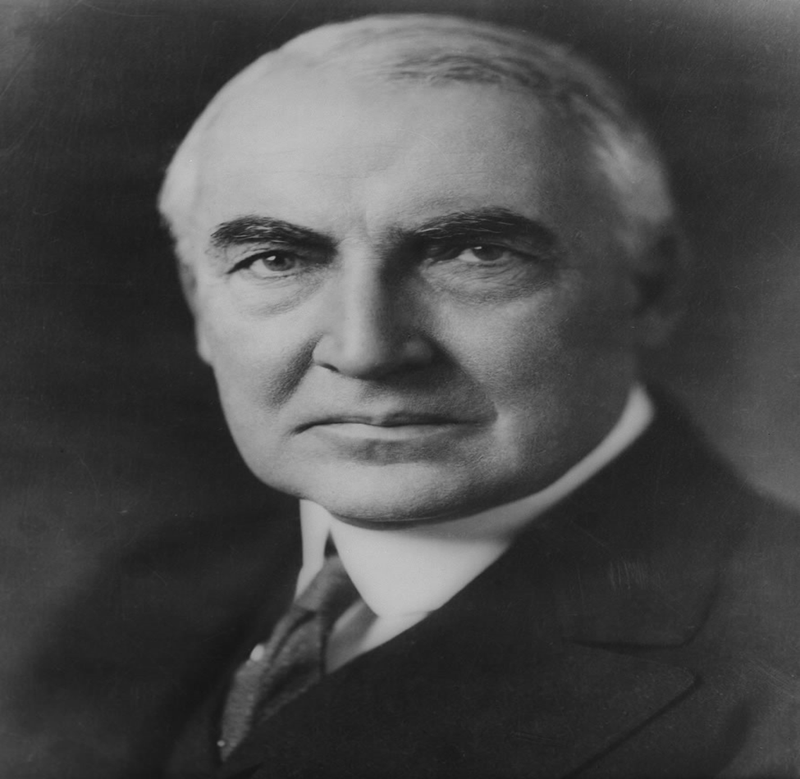
THE HARDING PRESIDENCY
Election of 1920:
#4 Ohio Senator Warren G. Harding won promising simple times, a return to normalcy. However his presidency was full of scandal and corruption.
#5 Ohio Gang:
Harding appointed friends to his Cabinet; they caused scandal and embarrassment.
*** cabinet- president appoints department heads.

Slide 10
#6 Teapot Dome scandal
Secretary of the Interior leased oil rich public land in Teapot Dome, Wyoming, to oil companies.
The Sec. of the Interior received hundreds of thousands of dollars in “loans, bonds, and cash”.
Harding “I have no trouble with my enemies… but my friends… they are the ones keeping me walking the floors at night!”
In August, 1923, Harding suddenly died from a heart attack or stroke.
Vice President Calvin Coolidge assumed the presidency.
He did restore faith in the government
Was elected himself in the 1924 election.

Slide 11
President Calvin Coolidge

Slide 12
PRES. CALVIN COOLIDGE: THE BUSINESS OF AMERICA
#8 Pro-Business (Laissez-Faire): President Coolidge, like most presidents of the era, was pro-business.
They believed that business was America’s most valuable resource and wanted to return to a more laissez-faire economic climate.
1920s Economic Boom: This was aided by:
#7 Fordney-McCumber Tariff (high tariffs)
which leads to more American goods being bought/sold
a reduction in income taxes, and rising wages.
which allowed people to have more disposable income, so they spent it on non-essential items and new convenient products

Slide 13
Assembly Line:
Innovation that sparked this economic boom. Allowed faster production at decreased prices.
#9 Henry Ford -Automobile industry benefited from the Assembly line.
Changed our cultural landscape that continues to exist today.
Impact of the automobile on American society:
More families could afford to buy cars
Businesses grew rapidly: restaurants, hotels, and gas stations
Promoted greater mobility for people
#10 Urban sprawl- the spreading out of cities

Slide 14
Model T

Slide 15
Influences how people spent money:
Buying on the #11installment plan- buying/paying for goods over time.
Electricity made life easier: refrigerators, vacuums, and washing machines.
Advertising- made people feel that they needed items
Rural Americans valued #17 traditionalism, moral truth comes from God. They resisted change.
Farmers- did NOT enjoy the economic boom of the 1920s.
New innovations contributed to massive overproduction resulting in decline in crop prices.
Farmers suffered economically when many Americans were flourishing.

Slide 16
1920s Advertisements

Slide 17
CHANGING WAYS OF LIFE
“Roaring” 20s- The 1920s were a time of massive economic growth. Businesses and factories were very profitable earning this nickname.
Social Issue: #12 Prohibition: The manufacturing, selling, and transporting of alcohol was legally prohibited
This was put into effect with the passage of the 18th Amendment to the Constitution.
Resulted in the #13 rise of organized crime as people like Al Capone made millions in illegal alcohol sales. Also led to bootleggers and the operation of #14speakeasies, illegal bars.

Slide 18
1920s GANGSTER
AL CAPONE
ARMORED CAR

Slide 19
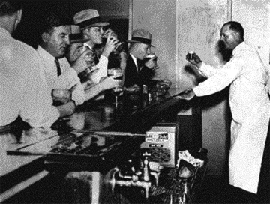
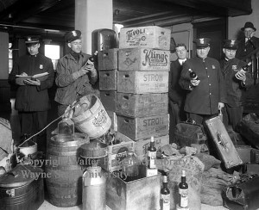
SPEAKEASY PICS FROM THE 1920s

Slide 20
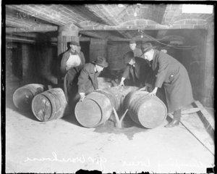
PROHIBITION PICS FROM THE 1920S

Slide 21
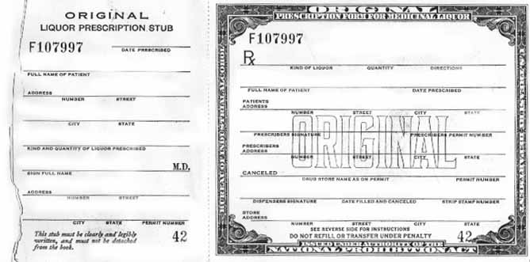
#12 The 18th Amendment was repealed by the 21st Amendment (1933) as Prohibition proved too hard to enforce.

Slide 22
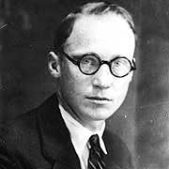
Social Issue: Science v. Religion
The 1920s also saw a rise in religious #15 fundamentalism- movement grounded in the literal interpretation of the Bible and general skepticism of scientific knowledge.
In 1925 Tennessee it was against the law to teach evolution in school as it opposed the Bible’s account of creation. (Other states outlawed it too.)
Biology teacher #16 John Scopes, with the backing of the American Civil Liberties Union (ACLU), continued to teach the theory of evolution. He was arrested, found guilty and fined $100.

Slide 23
Analyze the following cartoon:

Slide 24
THE TWENTIES WOMAN
Social Issue: Growing sense of independence, a rejection of many 19th century values, and a demand for the same freedoms of men.
One group that emerged as the radical women in 1920s society was the #19flappers- Modern young women that embraced the new fashions and urban attitudes.
Characteristics :
Wore dresses above the knee
Cut their hair short and many dyed it jet black
Openly smoked, drank, and even discussed sex
Marriage was viewed as an equal partnership
Few in number

Slide 25
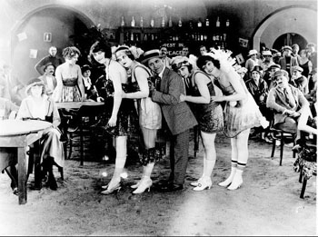
Women make strides in employment and education. Conveniences, from birth-control to technology, continue to everyday life of women.
#18 Modernist felt the traditional life was becoming outdated in the new economic, social, and political environment of an emerging fully industrialized world.

Slide 26
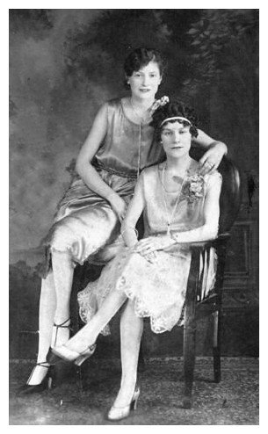

Slide 27
EDUCATION AND POPULAR CULTURE
Social Issue:
School enrollment increased dramatically
News coverage expanded through radio, as well as newspaper and magazine more people reading! (Reader’s Digest (1921) and Time (1923)
#20 Charles Lindbergh was the first to fly across the Atlantic
Some of our richest literary history comes from the 20s
Sinclair Lewis
F. Scott Fitzgerald
Ernest Hemingway
Much of the writing of authors like Lewis and Fitzgerald was critical of society. People’s desire for material objects was one such thing.

Slide 28
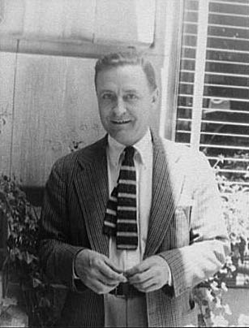
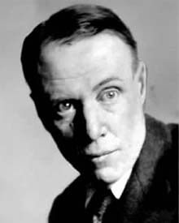
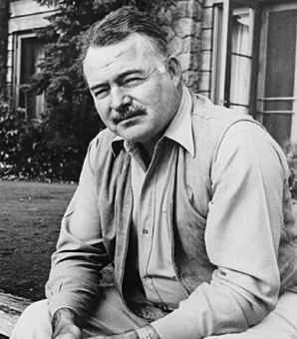
#21 The Lost Generation-Some writers became sour with the materialism in American society, they moved to Paris.
Sinclair Lewis F. Scott Fitzgerald
Ernest Hemingway

Slide 29
#23 THE HARLEM RENAISSANCE
#22Great Migration- 5 million African-Americans migrated to northern cities for jobs. 1920, 40% of the U.S. African-Americans lived in cities.
Many settled in the New York City borough of Harlem, which had problems- overcrowding, unemployment, and poverty.
Problems overshadowed in the 1920s the #23 Harlem Renaissance- literary and artistic movement celebrating African-American culture.
Harlem Renaissance (writers, poets, artists, musicians, etc…) encouraged a African-Americans to celebrate their culture.
One creative aspect that took off like wildfire throughout Harlem was jazz music. Clubs in Harlem were some of the best in New York City to listen to jazz.

Slide 32
With the growth in population came a renewed discrimination from people in the North. This will lead to the rise of the NAACP (National Association for the Advancement of Colored People).
An influential figure of the time was #24 Marcus Garvey. He promoted African-American business and the idea of returning to Africa to create and build a powerful nation. All this collapsed when he was arrested and convicted of fraud.

