Slide 1
The Persians and the Greeks
Chapter 3 105-117

Slide 2
Common Characteristics of Empire
Empire – an aggressive state that conquers, rules, and extracts resources from other states and peoples.
Diverse
Oppression
Provide peace and stability
Conduit of goods and ideas
Collapse

Slide 3
Questions for Empires to Answer
Should we impose our culture on the people we conquer?
Should we rule directly or indirectly?
How can we extract money and resources while maintaining order?
When should we stop?

Slide 4
The Persians
500 B.C.
Achaemenid Dynasty
Cyrus and Darius
Their empire stretched from Egypt to India.
35-50 million people lived under the Persian Empire.
These people constituted dozens of different races, languages, cultures, and states.

Slide 5
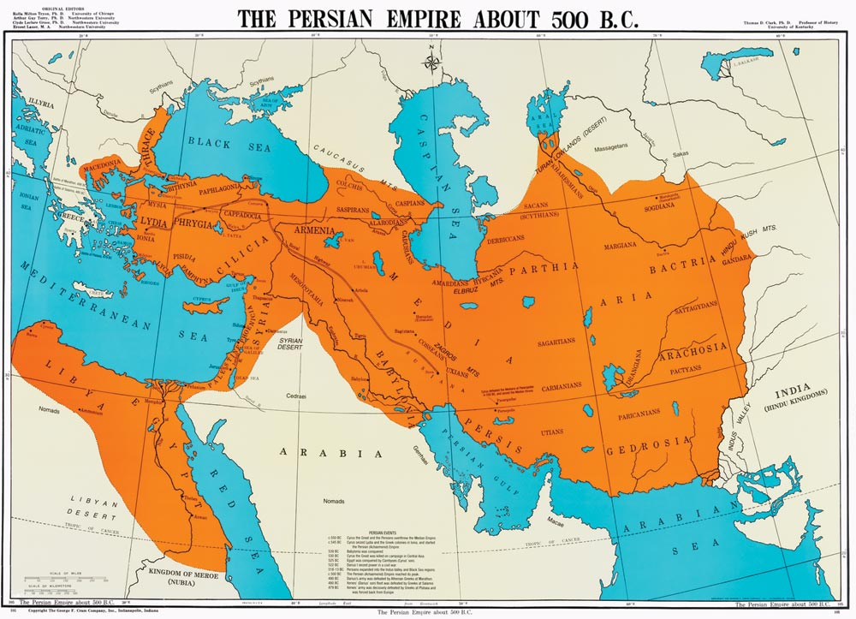

Slide 6
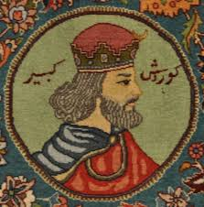
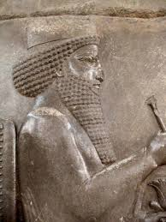
Cyrus and Darius

Slide 7
The Persians - Government
Elaborate cult of kingship
Kings were given their power by the gods and had absolute power.
However one man cannot rule over 50 million people alone.
Satraps – Persian governors who ruled over Persia’s different territories.
However, lower level officials were drawn from the local authorities.

Slide 8
The Persians - Culture
The Persian Empire was tolerant of cultures within their empire.
People were allowed to continue their cultural traditions as long as they paid their taxes and did not challenge the King.
539 B.C. – Cyrus allowed the Jews to return to their homeland and rebuild their temple in Jerusalem.

Slide 9
The Persians – Infrastructure
The Persians had standardized money and predictable taxes.
They used the taxes to build a canal connecting the Nile to the Red Sea, a “royal road” of 1,700 miles, and intense irrigation systems, among other projects.
This facilitated trade and allowed for quick communication throughout the empire.

Slide 10
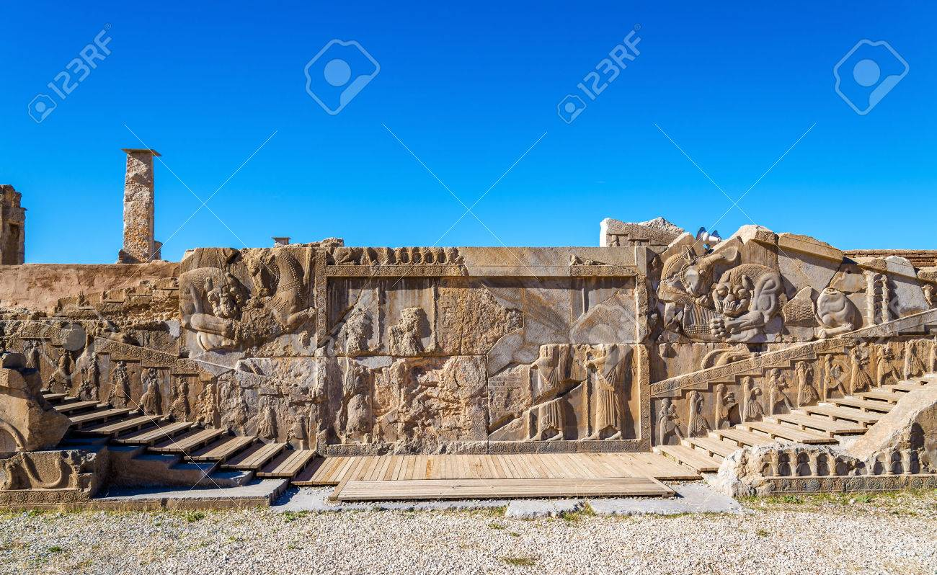
Persepolis

Slide 11
The Greeks
750 B.C.
Small competing city-states
Democracy?
2-3 million people

Slide 12
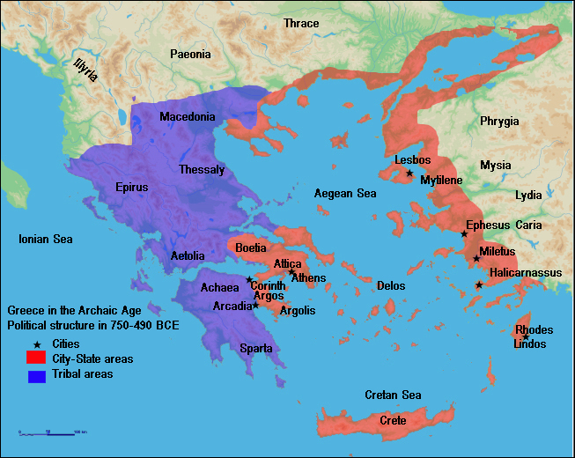

Slide 13
The Greeks – City-States
Divided by geography
Between 500-5,000 male citizens in each.
Fiercely independent and often came into conflict with each other
However, they spoke the same language and worshipped the same gods.
Olympic games began in 776 B.C.

Slide 14
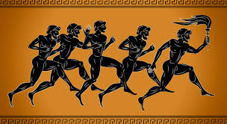
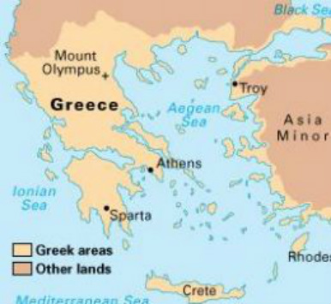

Slide 15
Greek – Building an Empire
Expansion by emigration instead of conquest.
Spread Greek culture as they settled in different places.

Slide 16
Greek – Politics
Promoted the idea of “citizenship”
Citizens could participate in public decision making and were treated as equal under the law.
Who were citizens?
Athenian democracy

Slide 17
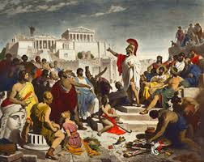

Slide 18
Greco-Persian Wars
Around 500 B.C. the expansions of the Greek Empire and Persian Empire collided on the Ionian coast.
The Ionian Greek cities revolted against the Persian Empire with the support of Athens.
The Persians attacked these Greek cities and Athens twice in ten years, but surprisingly failed both times.

Slide 19
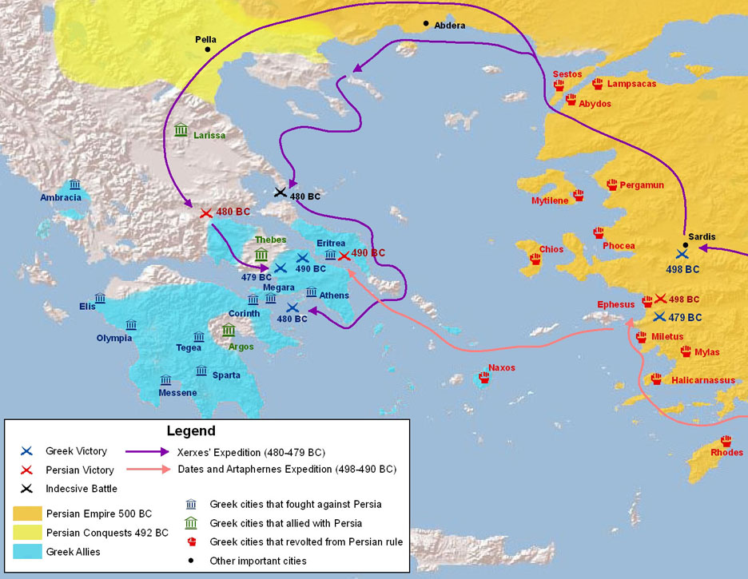

Slide 20
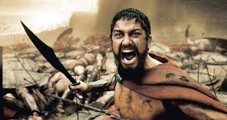
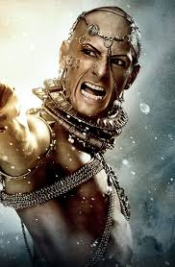
This is Sparta!!!!!!!!!!
https://www.youtube.com/watch?v=1NV9DSykTbo.

Slide 21
Greco-Persian Wars
This defeat had little effect on the Persians.
However, this victory had great impact on the Greeks.
It became an intense symbol of pride in their country and their values.
It radicalized Athenian democracy.
The fifty years after the Greco-Persian Wars were the golden age of Ancient Greece and Athenian democracy.

Slide 22
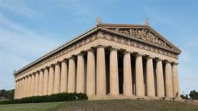
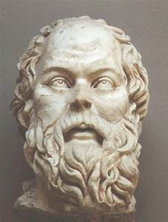
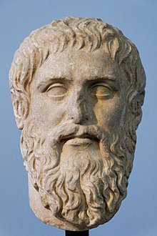
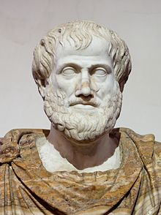

Slide 23
Pride Before the Fall
After defeating the Persians, Athens attempted to solidify their power among the Greek city-states.
This resulted in the Peloponnesian Wars between Athens and Sparta along with other Greek city-states.
Athens lost, but so did all of Greece. These wars weakened the Greek Empire and left them open to takeover by another power.

Slide 24
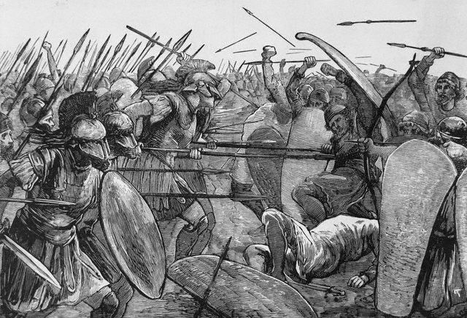
Peloponnesian War

Slide 25
Alexander and the Hellenistic Era
In 338 B.C. King Philip II of Macedonia was able to conquer and unite the bickering Greek city-states.
Soon after, Philip’s son, Alexander, planned a massive assault on the Persian Empire.
This united Greeks, as they wanted vengeance for Persian aggression in the past.

Slide 26
Alexander the Great
Over the course of ten years, Alexander soundly defeated the Persians and created a Greek empire from Egypt to Afghanistan.
However, he died before ever making it back to Greece.
His legacy lies in the dissemination of Greek (Hellenistic) culture. Historians call this the Hellenistic Era.

Slide 27
