Slide 1
Rome and China
Chapter 3

Slide 2
Rome
Rome started as a small city-state in central Italy.
It soon transformed into one of the greatest empires of all time.

Slide 3
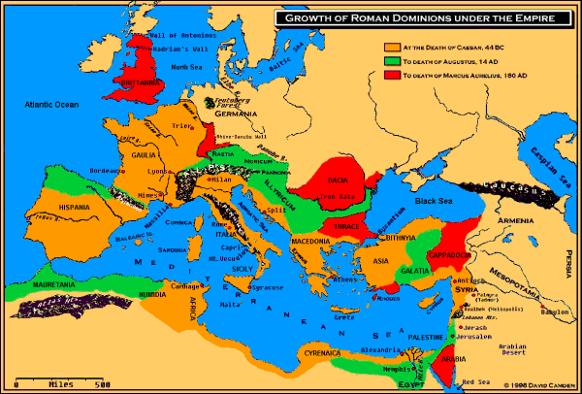

Slide 4
Roman political life
Early in their history, Romans rejected the monarchy and embraced a republic.
At first, the patricians maintained control of the government with two consuls at the helm.
These consuls were advised by the Senate.
Soon the lower class Plebeians demanded more rights and participation in Roman society.

Slide 5
Roman Law
“The values of the republic – rule of law, the rights of citizens, the absence of pretension, upright moral behavior, keeping one’s word…”
These were the ideal standards for Roman political life early on.

Slide 6
However, Roman Republican ideals could not withstand the expansion of the Roman empire and soon gave way to autocratic rule by different emperors.

Slide 7
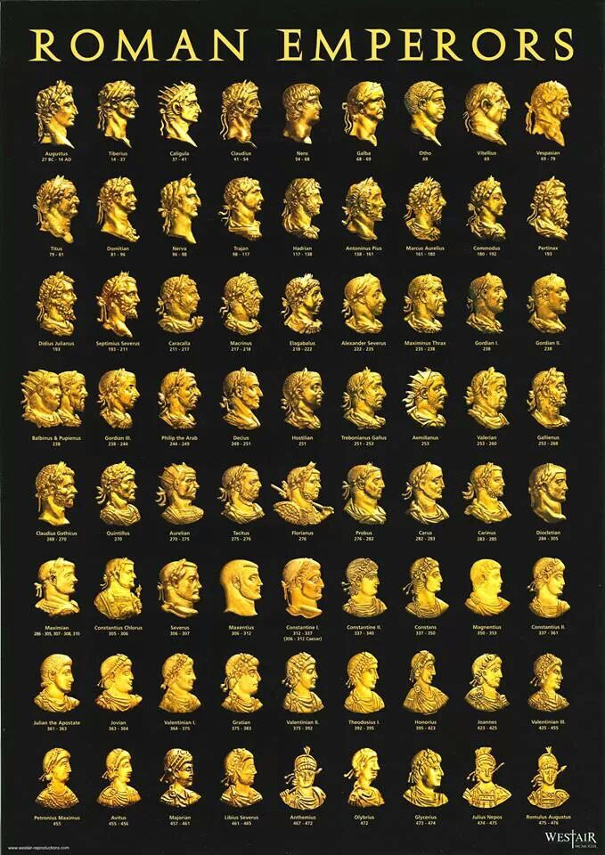

Slide 8
Pax Romana
What was the pax romana?
Why was it important?

Slide 9
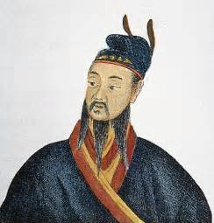
Qin Dynasty
Qin Shihuang reunited the warring state of China to recreate a new Chinese Empire.

Slide 10
Legalism
Qin used strict and clear rules to administer his empire.
Harsh punishments were given to those who broke the law.

Slide 11
Qin’s Rule
Qin’s expansion was often brutal and relied on strong military force.
Dissidents were either killed or moved closer to the capital so the emperor could keep an eye on them.
To keep out foreigners, Qin built the Great Wall of China using coercive labor.

Slide 12
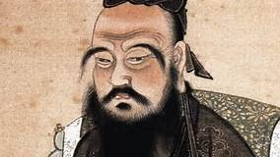
The Fall of Qin
Because of his brutal rule, the Qin dynasty fell quickly and was replaced by the Han dynasty.
The Han dynasty rejected legalism for a more moderate philosophy known as Confucianism.

