Slide 1
THE CIVIL RIGHTS MOVEMENT and JFK’s America
Unit 10
CHAPTERS 18 and 20

Slide 2
TAKING ON SEGREGATION
Civil rights- those legal rights retained by citizens and protected by the government (examples are the right to vote and anti- discrimination laws).
The Civil Rights Movement of the 1950s and 60s was the actions taken by African-Americans to obtain these many legal rights and equality. The main purpose or goal of this civil rights fight was provide equality to all regardless of race.
Civil Rights Decisions:
Brown v. Board of Education of Topeka- Supreme Court ruled segregation in schools was unconstitutional (led to desegregation/integration of all public schools in the U.S.)
Brown II- Supreme Court ordered school desegregation had to be implemented “with all deliberate speed” (since many had been dragging their feet in doing it)

Slide 3
Reactions to the Brown decisions:
Some states and school systems implemented it immediately with little problem
Some states and school systems vowed total resistance
The most glaring resistance happened in Little Rock, AR, at Central HS in 1957. Arkansas Governor Orval Faubus ordered the natl. guard to prevent 9 black students (the Little Rock Nine) from entering Central HS. This situation ended when Pres. Eisenhower ordered the natl. guard and U.S. paratroopers to watch and protect the nine as they attended class.
Civil Rights Act of 1957- can be summarized by saying that the federal government was given power to better enforce civil rights

Slide 4
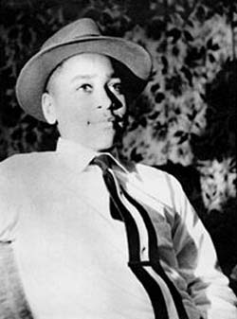
Important people in the civil rights movement:
Emmett Till- 14 yr. old African-American boy murdered in 1955 for allegedly flirting/whistling at a white woman

Slide 5
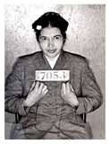
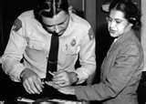
Rosa Parks
Rosa Parks- she refused to get up from her seat on a Montgomery City bus. She was arrested.
Martin Luther King Jr. was called in to organize a response to Ms. Parks’ arrest. He started the Montgomery Bus Boycott. (1955)
This event started the resistance phase of the civil rights movement

Slide 6
Many different civil rights groups were started during the 1950s/60s. So many existed b/c African-Americans could not come to a common agreement on how to gain equality in society. Some of these organizations with different blueprints for change were:
NAACP- National Association for the Advancement of Colored People (used education and law for change)
SCLC- Southern Christian Leadership Conference (nonviolence)
SNCC- Student Nonviolent Coordinating Committee (thought change was too slow and had to be spurred along)
CORE- Congress of Racial Equality (staged events like sit-ins)

Slide 7
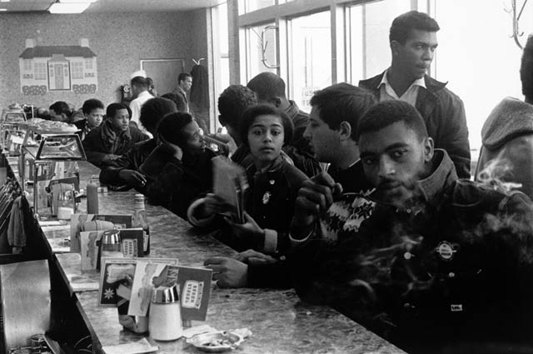
The 1960s were a crucial, yet volatile time for integration. All protest events like sit-ins, bus boycotts, enrolling in schools, and freedom rides were aimed at winning the battle for integration through the use of non-violent means.

Slide 8
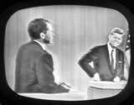
JFK becomes POTUS
1960 Presidential Election
Democrat John F. Kennedy against Republican VP Richard Nixon
First televised debate occurred during this election
TV, Cold War, and civil rights were major issues in this election
Kennedy won by fewer than 120,000 votes

Slide 9
THE NEW FRONTIER
When Kennedy took office in 1961, his message to Americans was built on a promise of progress. He called this the New Frontier- legislative program designed to increase international aid, expand the space program, aid education, help the elderly, rebuild poor urban areas, and bolster national defense.
New Frontier legislation and programs:
The Economy:
Cut taxes by $10 billion
Increased minimum wage to $1.25/hr
Pushed deficit spending by the govt. to stimulate an economy in a recession
Building the National Defense:
Increased military funding
Troops and nuclear weapons
Started the Green Berets

Slide 10
International aid
Created the Peace Corps- program of volunteer assistance to developing nations in Africa, Asia, and Latin America; became a huge success (35,000 volunteers in 60 nations)
Alliance for Progress- offered economic and technical assistance to Latin American countries; goal was to prevent further spread of communism in Latin America by promoting economic development
Beating the Russians (the Space Race)
U.S. space program called NASA (Natl. Aeronautics and Space Administration) began constructing a launch site in Florida and a mission control center in Houston, TX
Kennedy proclaimed our space goal was to land a man on the moon during the decade of the 1960s—Apollo program
As a result of the space program, schools and universities expanded their science and math courses, and space and defense related industries grew rapidly

Slide 11
Civil Rights
Poverty and civil rights went hand in hand as much of the nation’s poverty was experienced by African-Americans
In 1963, Kennedy called for a “national assault on the causes of poverty”
He also has the U.S. Attorney General (his brother Robert Kennedy) investigate racial injustices in the South

Slide 12
TRIUMPHS OF A CRUSADE
In 1961, civil rights advocates began a series of “freedom rides” throughout the south. Freedom rides- bus trips through the south aimed to test the Supreme Court ruling to desegregate seating on interstate bus routes and facilities in bus terminals.
These rides were met with great violence, but it forced the govt. to take notice. Marshalls will be sent to protect the riders and the U.S. Atty. General proclaimed a ban on all segregated travel facilities.

